Slide 1

새싹 디발자 키우미 - designer helper
캡스톤 디자인 01분반
프로젝트 제안 발표

Slide 2


About Team & Role
Project Motivation
Project Goal & Details
Project Development – Language & Platform
Project Schedule
Other Ideas
content

Slide 3
About Team & Role
Team Member & Roles
20155604 구동완 - Back-end Development
20186738 김민지 – Front-end Development
20151012 최현준 – Content Development
Team o8o

Slide 4
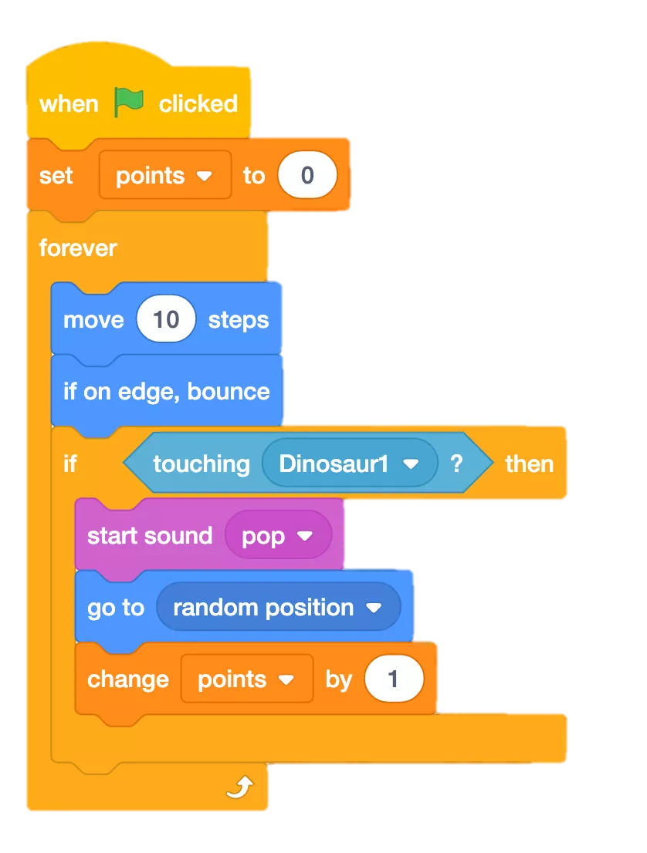
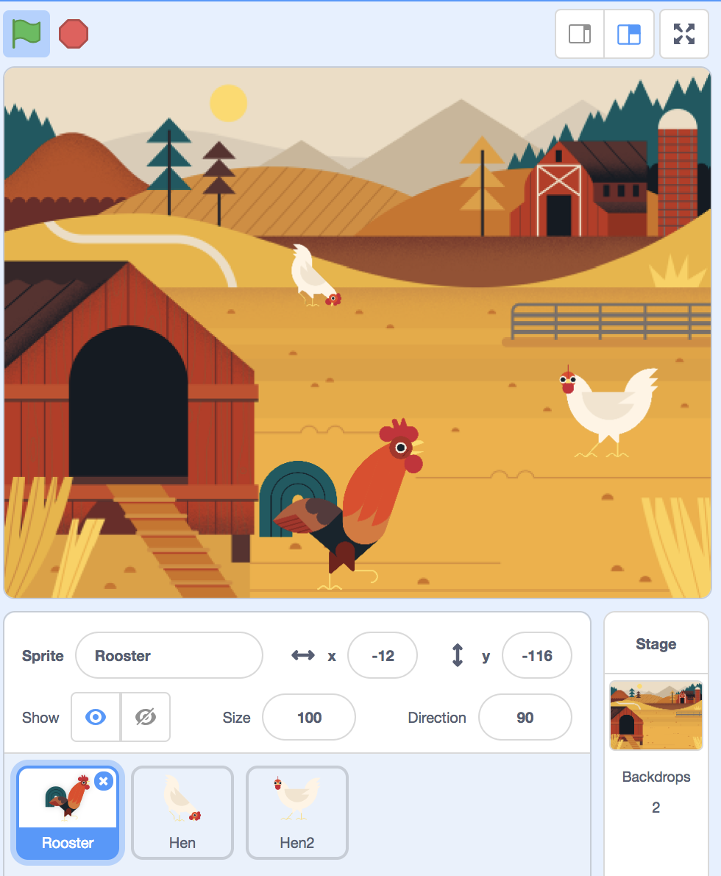

2. Project Motivation
Many people are having a hard time learning a new computer language.
< Example of Scratch >

Slide 5

2. Project Motivation
Many people are having a hard time learning a new computer language.
We designed a project that relieves the burden by using block coding
< Example of Scratch >

Slide 6
2. Project Motivation
Many people are having a hard time learning a new computer language.
새싹 디발자 키우미 ?
We designed a project that relieves the burden by using block coding
< Example of Scratch >

Slide 7


3. Project Goal & Details
Lowering entry barriers for computer language beginners.
- Automatically convert assembled blocks to Python code
- Help solve problems appear in development with SNS
functions ( information and Q&A bulletin board )
- Convert a screen drawn by a designer to a react code

Slide 8



4. Project Development – Language & Platform

Slide 9
5. Project Schedule
week | Development Schedule
1 | Idea planning and preparation for presentation
2 | Determining the project content and Distributing detail roles - 1
3 | Language study and Distributing detail roles - 2
4 | 최현준 Block coding Content Development | 김민지 Front-end /SNS Development | 구동완 Back –end /SNS Development
5
6
7
8 | Functional Integration and Bug fixing Second demo preparation
9 | Functional Integration and Bug fixing
10 | Development of additional React functions
11 | Development of additional React functions
12 | Development of additional React functions
13 | Functional Integration and Bug fixing Final Demo preparation
14 | Final Demo

Slide 10

6. Other Ideas
Other Ideas for “새싹 디발자 키우미”
Allows users to specify the color and appearance of code blocks
Support for other languages besides Python
Autocomplete function

Slide 11

6. Other Ideas
VR AR Studio: A app that helps designers and developers cooperate when using 3D designs such as AR and VR
AR 같이 사진 찍자: These days, it's hard to go outside. So you can combine your pictures using cell phone and make it feel like you're on a trip.
방 사진 인테리어 평가: When you upload a picture of the room, it recognizes the layout of the furniture and scores it. It also recommends colors and interior tips that go well with it.
운동 코스 추천: Based on location data, this app recommends exercise courses that are suitable for users.
자취생 공동구매: Based on location data, this app helps residents to purchase essentials (such as water, shampoo… ) together.
Other
Project
Ideas

Slide 12
Thank you

